Slide 1
2024 Open Enrollment Presentation

Slide 2
Agenda
Open Enrollment Overview
Medical: HPHC Plans (with pharmacy benefits through OptumRx)
  Networks, Designs, Cost
Additional Benefits
Next Steps: How to Enroll & Additional Resources

Slide 3
Open enrollment overview

Slide 4
Open Enrollment Overview
2023 Open Enrollment is November 1–15, 2023
NEW
  Medical: Plan design changes for all plans
  Dental: Right Start 4 Kids Program
  Vision: EyeMed 360 Program
  BeWell @ Holy Cross: HPHC Wellness program enhancements and DetecTogether
  There are no changes to FSA, HSA or EAP carriers or plan designs.
  ACTION REQUIRED:
  You must actively enroll in medical, dental, and vision coverage.
  You must also actively elect to participate in the Health Care and Dependent Care Flexible Spending Accounts (FSAs) and Health Savings Account (HSA) each year. Your 2023 elections will not roll over.
  Are you turning 65 in 2024? Enrollment in Medicare impacts HSA eligibility.
  You should review your dependents to be sure they are eligible. You will also be asked to provide Social Security numbers for your dependents.

Slide 5


HPHC’s HMO & PPO Networks
80,000 doctors and other clinicians and more than 153 hospitals across Harvard Pilgrim’s network
Focus HMO = MA (limited network)
HMO = New England (limited in CT)
PPO = National In-Network Coverage
Follow the below link to find your
in-network providers: https://www.harvardpilgrim.org/public/find-a-provider
Access to the largest national network in the USA with more than 1.5 million+ providers and more than 6,700+ hospitals provided by UnitedHealthcare
PPO:
No PCP designation required
No referrals necessary
Can access services IN or OUT of network services (out of network will result in higher cost)
*OON services may be subject to balance billing.
HMO:
Only available to employees in MA, ME, NH, RI and VT (limited CT access)
Must select an in-network PCP
Referrals are required for most specialty care
Emergency Services Covered worldwide
*Must remain in-network for all other services
Effective January 1, 2024, HPHC will redefine its HMO enrollment area to exclude the majority of Connecticut.

Slide 6
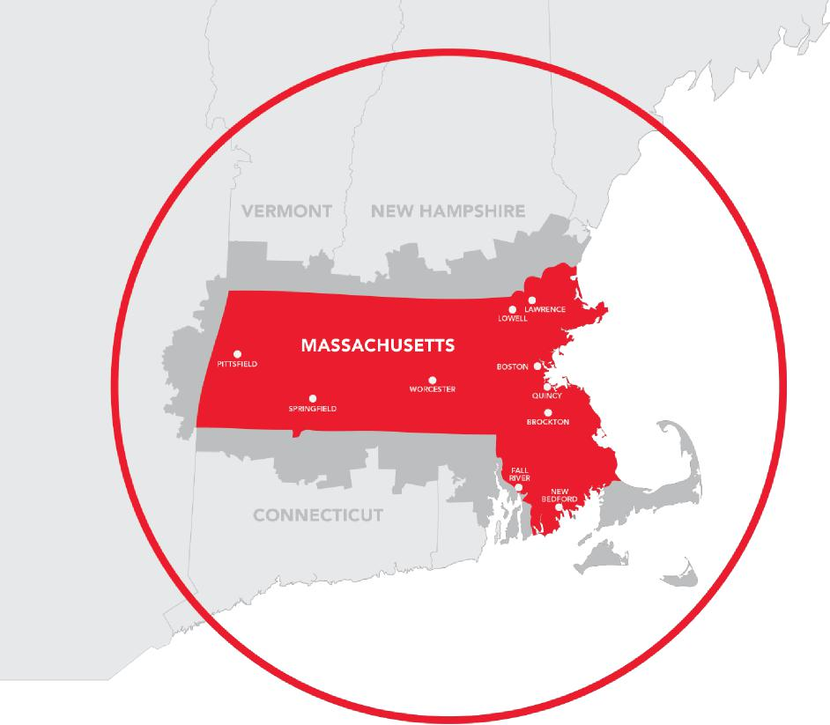
HPHC’s Focus NetworkSM ⎼ MA HMO
Focus Network = Limited Network (MA Only)
Member enrollment area
Employer enrollment area
Providers who participate in the Focus Network are also referred to as Easy Access providers.
In this plan, you have coverage only from providers in the Focus Network.
Authorized Access: UMASS Memorial Hospital providers are not part of the Focus Network. On rare occasions and with prior authorization from Harvard Pilgrim, members may see these approved providers.
5 / © Harvard Pilgrim Health Care

Slide 7

2024 Medical & Prescription Dug Plan Options
Benefit Summary | Focus HDHP HMO (MA) | HDHP PPO (National) |  | Focus HMO (MA) | HMO (MA/RI/NH/ME)
 | In-Network | In-Network | Out-of-Network | In-Network | In-Network
Deductibles | $2,000/ $4,000 | $2,000/ $4,000 | $4,000/ $8,000 | $500/$1,000 | $1,000/$2,000
Holy Cross HSA Contribution | $500/$1,000 | $500/$1,000 |  | n/a | n/a
Coinsurance | 100% | 100% | 80% | 100% | 100%
Out-of-Pocket Maximums
Medical and Prescription Drug Combined | $4,000/$8,000 | $4,000/$8,000 | $8,000/$16,000 | $2,500 / $5,000 | $2,500 / $5,000
Office Visits
Annual Preventative Exam | Plan pays 100% | Plan pays 100% | Plan pays 80% | Plan pays 100% | Plan pays 100%
Routine Vision Exam | Plan pays 100% | Plan pays 100% | Plan pays 80% after deductible | Plan pays 100% | Plan pays 100%
Office Visits (PCP) | $30 copay after deductible | $30 copay after deductible | Plan pays 80% after deductible | $30 copay after two visits ($0 copay for the first two visits) | $30 copay after two visits ($0 copay for the first two visits)
Specialist Visits | $50 copay after deductible | $50 copay after deductible | Plan pays 80% after deductible | $50 copay | $50 copay
Emergency Care
Emergency Room | $100 copay after deductible | $100 copay after deductible | $100 copay after deductible | $100 copay | $100 copay
Urgent Care | $30 copay after deductible | $30 copay after deductible | Plan pays 80% after deductible | $30 copay | $30 copay
Inpatient/Outpatient Services
Inpatient Hospital | Plan pays 100% after deductible | Plan pays 100% after deductible | Plan pays 80% after deductible | Plan pays 100% after deductible | Plan pays 100% after deductible
Ambulatory Day Surgery | Plan pays 100% after deductible | Plan pays 100% after deductible | Plan pays 80% after deductible | Plan pays 100% after deductible | Plan pays 100% after deductible
Diagnostic X-Ray/Lab | Plan pays 100% after deductible | Plan pays 100% after deductible | Plan pays 80% after deductible | Plan pays 100% after deductible | Plan pays 100% after deductible
Imaging (CT/PET Scans, MRIs) | Plan pays 100% after deductible | Plan pays 100% after deductible | Plan pays 80% after deductible | Plan pays 100% after deductible | Plan pays 100% after deductible
Prescription Drugs (through OptumRx) | Deductible applies then… | Deductible applies then…
Retail | $15/$45/$65 | $15/$45/$65 | Not Covered | $15/$45/$65 | $15/$45/$65
Mail | $30/$90/$130 | $30/$90/$130 | Not Covered | $30/$90/$130 | $30/$90/$130

Slide 8

Medical & Prescription Drug Plans: Employee Contributions
 | MONTHLY EMPLOYEE CONTRIBUTIONS | MONTHLY HOLY CROSS CONTRIBUTIONS
Focus HDHP HMO (MA)
Employee | $35.33 | $607.04
Employee + Spouse | $74.19 | $1,274.80
Employee + Child(ren) | $63.60 | $1,092.69
Family | $107.05 | $1,839.35
HDHP PPO (National)
Employee | $143.29 | $610.86
Employee + Spouse | $300.90 | $1,282.80
Employee + Child(ren) | $257.92 | $1,099.55
Family | $434.16 | $1,850.88
Focus HMO (MA)
Employee | $126.89 | $691.75
Employee + Spouse | $266.46 | $1,452.66
Employee + Child(ren) | $228.40 | $1,245.14
Family | $384.47 | $2,095.97
HMO (MA/CT/RI/NH/ME)
Employee | $276.08 | $692.62
Employee + Spouse | $579.77 | $1,454.52
Employee + Child(ren) | $496.94 | $1,246.71
Family | $836.52 | $2,098.64
Reminder: Holy Cross will make a lump sum HSA contribution of $500 (EE only) or $1,000 (Family tiers)

Slide 9
HPHC Behavioral Health: Self-Service Tools & Specialty Care
Personalized and effective care, with a focus on improving access to care and overall health outcomes.
Virtual Therapy Services
Available seven days a week to support your mental health and well-being, including licensed coaching, talk therapy, medication management and more:
AbleTo
Doctor On Demand
Valera Health
Specialty Care Providers
Quick and easy access to care for autism spectrum disorder for children, and outpatient psychiatry and therapy for adults, children and adolescents:
Cortica
Transformations Care Network
Substance Use Treatment
A range of treatment options, with support from our internal care management team after inpatient treatment:
Multiple network providers, including Spectrum Health
Our Addiction Recovery Care Management Team
If you’re experiencing a crisis or emergency, you should always call 911 or go to the nearest emergency facility right away.
9

Slide 10



HPHC Wellness Programs and Services
Living Well Online Portal
Holistic well-being program
Variety of wellbeing activities & monthly challenges
Syncs to wearable devices
Mobile & app accessible
Opportunity to earn rewards
Family Wellness
NEW Ovia Health: Family and women’s health resources
NEW Wellthy: Support for caregivers
NEW Included Health: Support for LGBTQ+ members
Reimbursement Programs
NEW Wellness: Reimbursements for qualified fitness activities, along with mindfulness and nutrition programs
Weight Management
Living Well at Home
Free, virtual fitness and wellness classes, including Zumba, yoga, barre
Wellness webinars
Mindfulness
Guided mindfulness sessions led by our team of expert instructors
Discounts & Savings
Exclusive savings on a wide range of programs, products and services to support your health and well-being
Health Coaching
For members age 18+, one-on-one support for issues like managing weight, smoking cessation, reducing stress and increasing physical activity
10

Slide 11
HPHC Digital Tools and Support
Get the most out of your Harvard Pilgrim plan with these tools
Secure Member Account and Mobile App
Log in or activate your secure online account at harvardpilgrim.com/create or download the Harvard Pilgrim mobile app to access your health plan benefits information
Find a Doctor or Hospital
Log in to your secure account to find a convenient location near you. Search for doctors or hospitals by name or location, find doctors accepting new patients, and view doctors by specialty
Estimate My Cost
Log in to your secure account to estimate your out-of-pocket costs and find a provider that will save you money
Reduce My Costs
Connect with a nurse at 855-772-8366 when you shop for a wide range of outpatient tests and procedures, including lab work and diagnostic imaging, and earn cash rewards when you select high-quality, cost-effective providers.
Telehealth provided by Doctor On Demand
Access a Doctor on Demand provider 24/7, by phone or mobile app worldwide for everyday care and confidential therapy. Set up your account at doctorondemand.com/harvard-pilgrim.

Slide 12
additional benefits

Slide 13
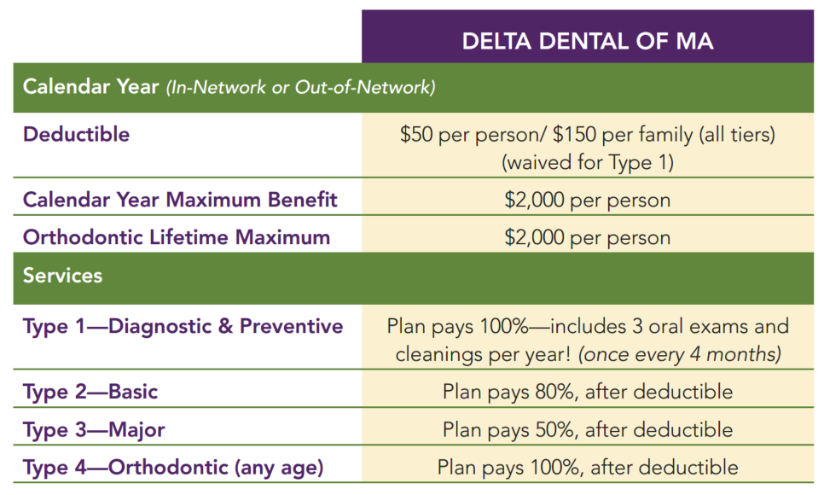

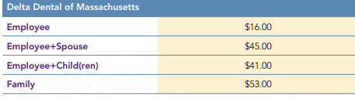

Dental Coverage: Plan Enhancement – No rate change
The Holy Cross dental plan covers up to $2,000 per enrolled person in eligible expenses and the full cost of 3 oral exams and cleanings per year (every 4 months).
NEW for 2024: Right Start 4 Kids Program
Employees enrolled in family coverage under our Delta Dental plan are automatically enrolled in Right Start 4 Kids, which provides increased coverage for children up to their 13th birthday, including:
No deductible
100% coverage for preventative, basic, restorative, and major restorative services
Follow the below link to access your Delta Dental Account: https://deltadentalma.com/members/login
OR
Scan the QR code with your mobile device to download Delta Dental’s mobile app

Slide 14
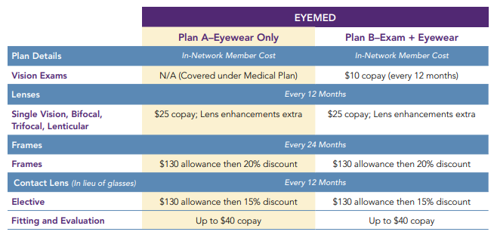
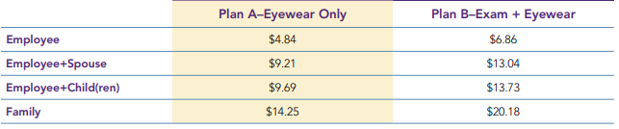

Vision Coverage: Plan Enhancement – No rate change
Choose between two plans through EyeMed: Eyewear Only or the Exam & Eyewear plan, which includes vision exams (every 12 months).
NEW for 2024: EyeMed 360 Program
Additional discounts are available when you use PLUS Providers:
$0 eye exam copay
Frames allowance of $180 (an additional $50)
PLUS Providers include Lenscrafters, Target Optical, Pearle Vision, 1-800 Contacts, and more.
Log in or create a new Member Web account at: eyemed.com/member
OR
Download the EyeMed Mobile App from App Store or Google Play

Slide 15


Spending Accounts Overview
Flexible Spending Accounts (FSAs) – tax advantaged, “use it or lose it”
  Health Care FSA – eligible medical, dental, and vision expenses
  Dependent Care FSA – eligible dependent care expenses
  Limited Purpose FSA – eligible dental and vision expenses, can be paired with an HSA
Health Savings Account (HSA) – triple-tax advantage, eligible medical, dental, and vision expenses, Holy Cross makes an annual contribution to your HSA of $500 for individual coverage and $1,000 for all other coverage tiers.
HSA: 2023 vs. 2024
2024 Individual coverage: increased $300
2024 Family coverage: increased $550
The catch-up contribution did not change
FSA: 2023 vs. 2024
To be determined
2024 IRS Maximums
HSA | Health Care FSA | Dependent Care FSA | Limited Purpose FSA
Individual coverage: $4,150 Family coverage: $8,300 Catch-up (55+): $1,000 | 2024 IRS Maximums have not been released | 2024 IRS Maximums have not been released | 2024 IRS Maximums have not been released
2023 IRS Maximums
Individual coverage: $3,850 Family coverage: $7,750 Catch-up (55+): $1,000 | Up to $3,050 | Up to $5,000 | Up to $3,050

Slide 16


DetecTogether
Program | Program Details | Comments
DetecTogether | DetecTogether (formerly known as 15-40 Connection), is a local, non-profit organization that educations individuals on importance of early cancer detection. Early deduction improves survival rates and reduces the cost and complexity of treatment. This program launched in May 2023. | Cancer is one of our top cost drivers. All employees and students have access to DetecTogether’s education platform, and DetecTogether will hold two live webinars. DetecTogether is free of cost for employees and students.

Slide 17
Next Steps: How to enroll

Slide 18
How to Enroll – HR Self- Service – PeopleSoft
Employees of the College elect coverages and changes via the College’s online self-service application, PeopleSoft. The instructions outlined below can be used on a computer, mobile device, or tablet.
HR Self-Service: How to Access and Log In
Go to www.holycross.edu and click on “Faculty & Staff” under the Audiences box at the top right of the page
Scroll down to “Employee Resources” and select “Human Resources (HR) Self-Service”
Input Network Username and Passphrase to log in
How to Enroll:
Click on the “Open Enrollment” tile (square)
Review the Welcome message, read and complete the agreement
Review your Dependents and Beneficiaries to ensure all information is correct and updated
Press the “Keep Current Medical/Dental/Vision” button if you are keeping your current medical, dental and vision benefits
Benefits that need to be reviewed will say “Needs Review” and will change to “Reviewed” once complete

Slide 19
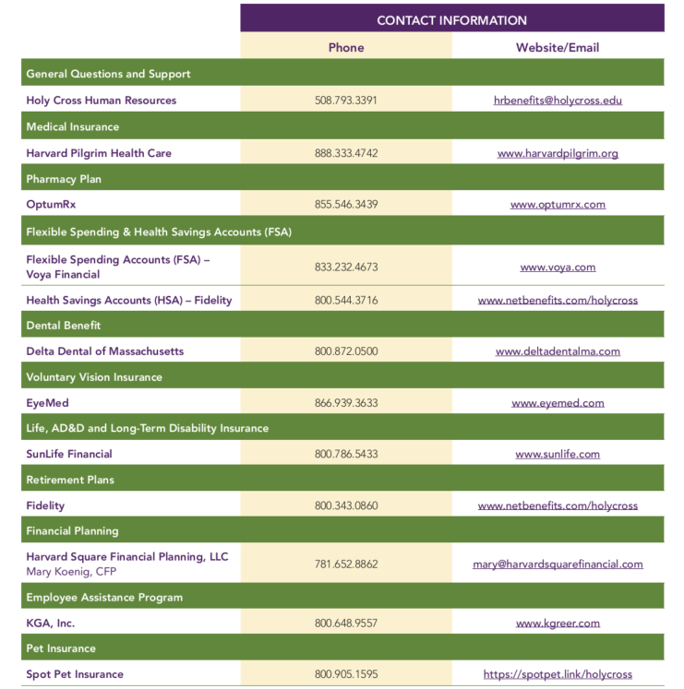
Additional Resources
Visit the Benefits Fair on November 6th!
12pm-2pm in the Hogan Ballroom
If you have any questions, please contact hrbenefits@holycross.edu or visit the Benefits Page:
www.holycross.com/human-resources/benefits

Slide 20
Questions?

